Slide 1
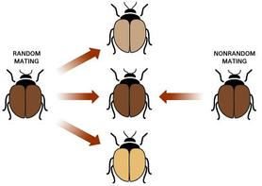
MORE ON VARIATIONS
Many excellent tools and tutorials
January 2020
Thanks for many PPT and Tutorials

Slide 2
UNDERSTANDING VARIATIONS

Slide 3
Revisiting definitions
alleles
Ref / Alt allele
Major / Minor allele.
Haplotype blocks
Linkage disequilibrium (LD)

Slide 4
Types / Genetic Variation
SNPs - mutations shared amongst a population
SNVs - private mutations
Indels
SV – structural variation
Somatic / Germline mutations
Coding / non-coding (not identical to exome/ non exomes)
Effect of mutation : Synonymous/ Missense/ Nonsense (=LoF)

Slide 5
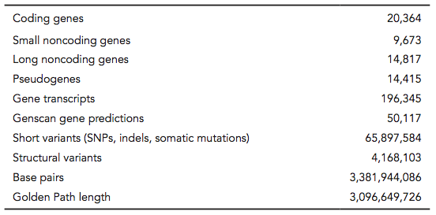
Human genome statistics from Ensembl
Ensembl Release 75
Ensembl is a comprehensive, authoritative resource for information about the human genome as well as other genomes.

Slide 6
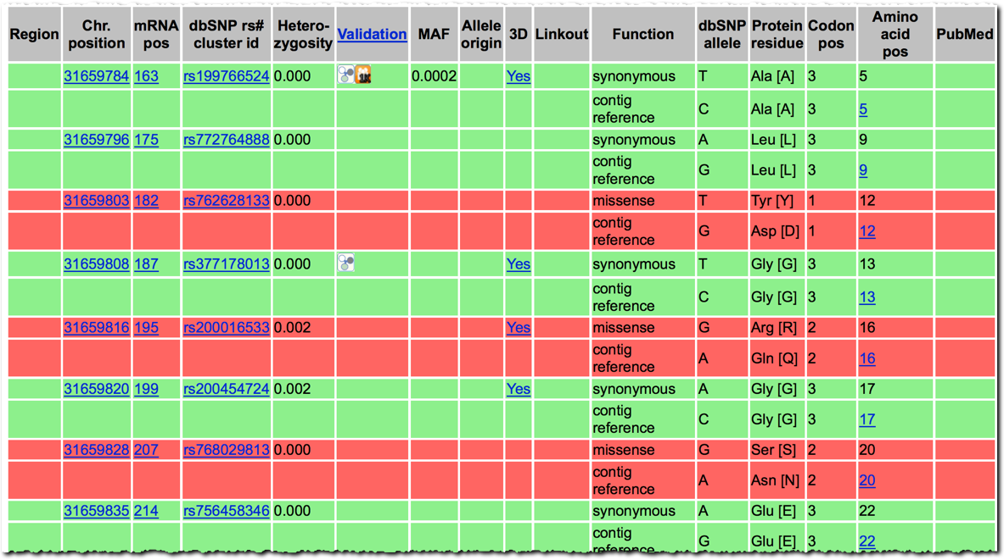
SNP: Geneview
NCBI: VARIATION

Slide 7
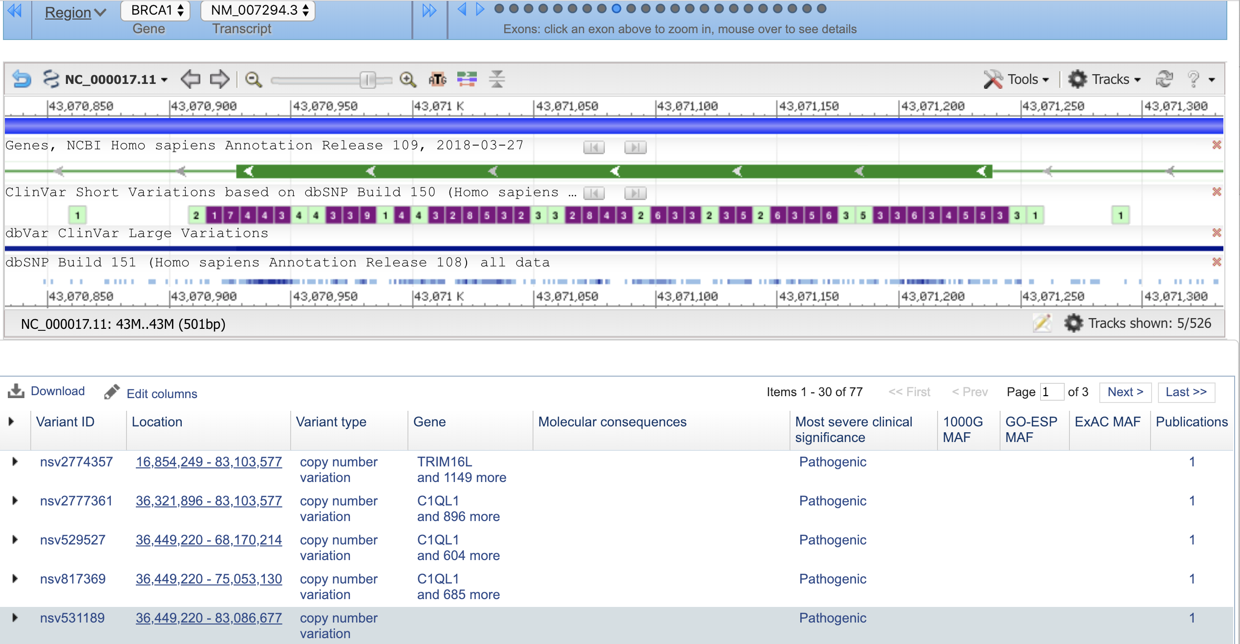
Variation Viewer (same browser for 1000G)
Select an exon
The pathogenic/ non pathogenic
Structural variation
Loss/gain
MAF

Slide 8
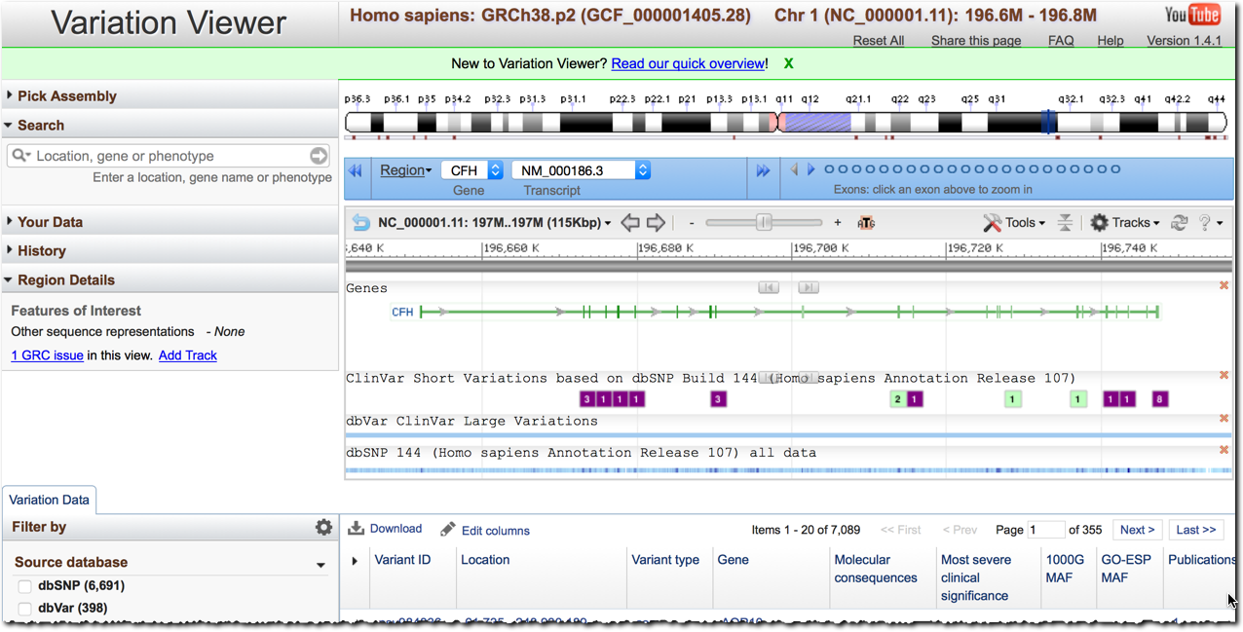
Variation Viewer (same browser for 1000G)

Slide 9
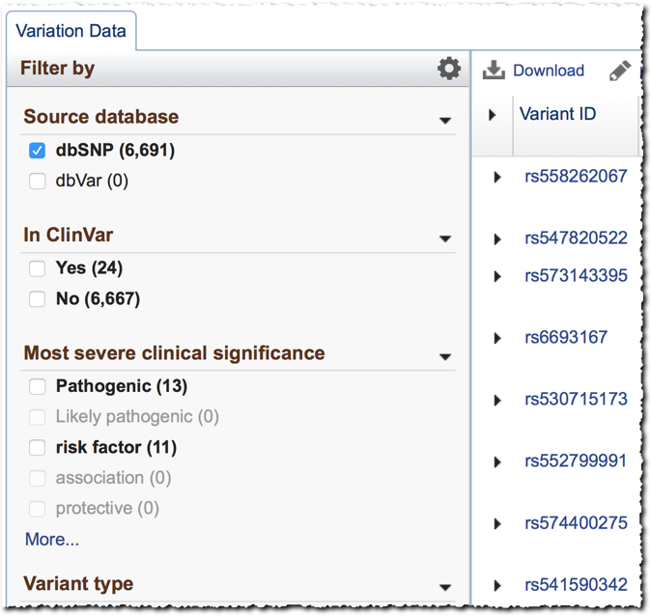
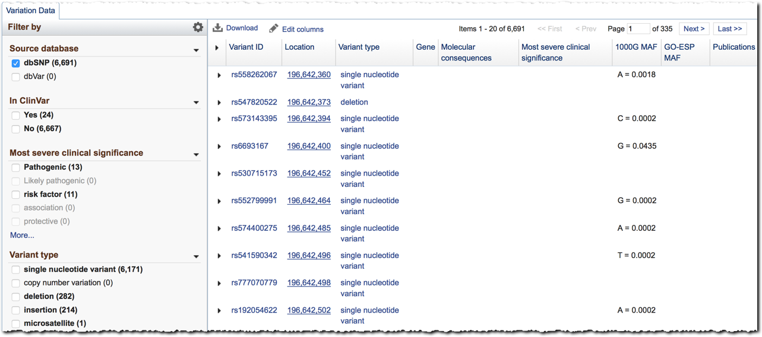
Variation Viewer Filters

Slide 10
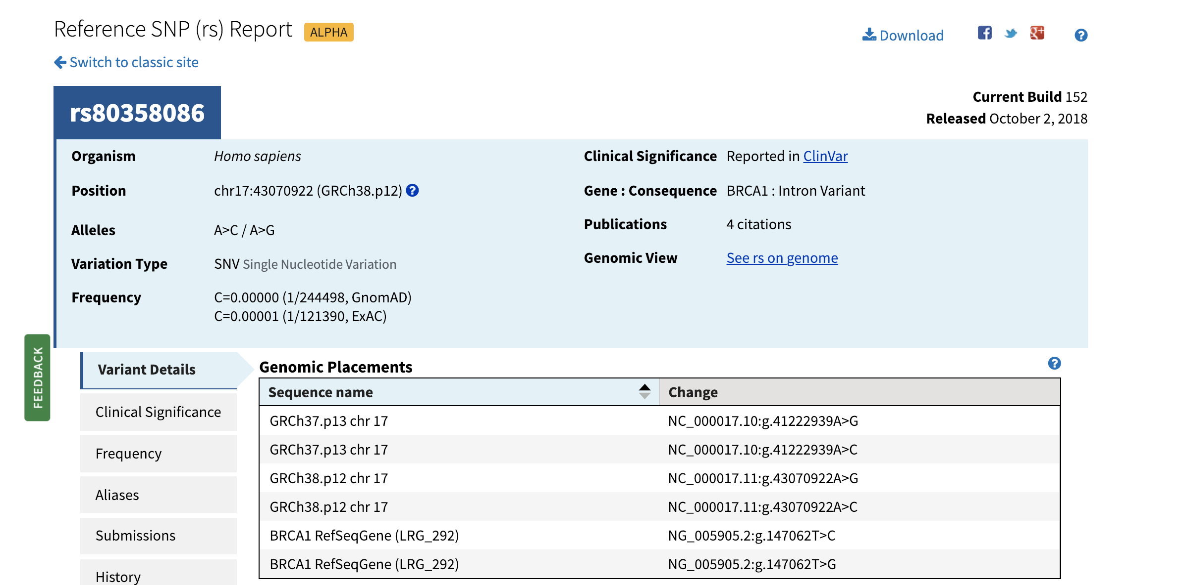
Variation Viewer (same browser for 1000G)

Slide 11
Overview – NGS Genomes, exomes and targeted panels
Genomic diagnosis: how do we filter causal variants from a patient’s entire genome?
Major challenges for NGS diagnosis

Slide 12
NGS allows us to sample the sequence position many times over
GTACTGACCAGTAGACATAGACGACTTTGACGGGATGTACGAGCCGTAGCTA
TAGACATAGACGACT
ACGGGATGTATG
GTACTGACCAG
GGGATGTATGA
GACCAGTAGAC
TTTGACGGGATG
ATGAGCCGTAGCTA
GTACGAGCCGTA
CCAGTAGACATA
TGAGCCGTAGCTA
GACATAGACGACT
GGGATGTATGAG
ATAGACGACTTTGA
GGGATGTACGAG
AGACGACTTTGAC
TACGAGCCGTA
TGTACGAGCCGTA
Challenges:
Mapping short reads
Variable coverage
Base-calling quality
Tend to be worse for insertions and deletions compared to SNPs
C -> T
(5 C / 5 T)
Notes:
With NGS we are able to sample the position many times, so here we have many looks at this mutation and this kind of information gives us confidence in the call.

Slide 13
In the clinics: Which technology to choose?
Technology | Percent of Genome Sequenced | Cost | Depth of Coverage
Whole Genome Sequencing | >95%
Whole Exome Sequencing | ~1.5% (protein-coding regions)
Targeted Sequencing | 0.005% - 0.1% (100s – 1000s of genes)
Notes:
High level overview of the types of sequencing
WGS = complete DNA sequence of the person/organism
Exome = all mutations in all exons PLUS other variations (such as small insertions/deletions)
Targeted = all mutations in all targeted exons PLUS other variations (such as small insertions/deletions) – use on a large collection of genese

Slide 14
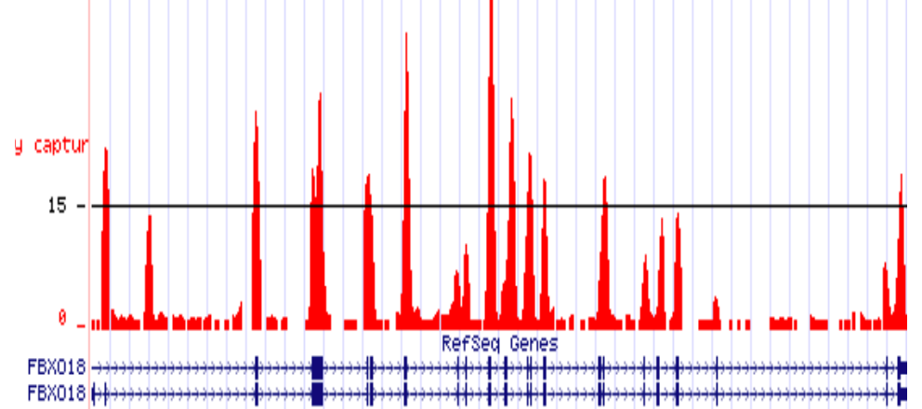
Targeted sequencing

Slide 15
1000G ExAC gnomAD ….

Slide 16
Variants found per individual at conserved sites
(from the 1000 Genomes Project)
Notes:
determinants of value

Slide 17
Variants found per individual at conserved sites
(from the 1000 Genomes Project)
Trio sequencing shows that each individual harbors on the order of 100 de novo variants.
Notes:
determinants of value

Slide 18
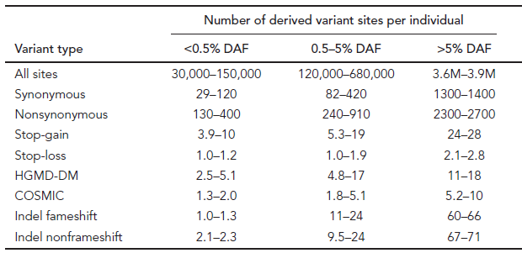
Variants found per individual at conserved sites
(from the 1000 Genomes Project)
DAF: derived allele frequency across sample
Notes:
determinants of value

Slide 19
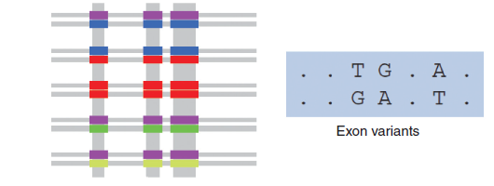
Unexpected lesion from the 1000G human variations
High rates of variation occur at the HLA
High rates of variation occur at the subtelomeric regions.
Lowest rates occur in a some gene-dense region around 3p21 (~5 M)
SNPs were imputed to support GWAS (not always justified)
Exon sequencing: haplotypes remain unphased
Notes:
determinants of value

Slide 20
How do we find pathogenic variants?
Is the variant a known pathogenic variant? How much evidence supports the claim of pathogenicity?
Is the variant rare?
Is it predicted to have a functional impact (change a protein sequence)?
Does it segregate with disease?
Is the gene associated with the disease?

Slide 21

Making sense of one genome requires tens of thousands of genomes
vs
More than 500K exomes and 50K genomes have been sequenced worldwide ----------
inconsistently processed

Slide 22
Variations at the population level
Evolution is the change in inheritable traits in a population over generations.
Change in traits is caused by changes in the the DNA that code for those traits.
Some individuals have traits that help them survive and reproduce, while others have traits that put them at a disadvantage.
Natural selection tends to increase favorable traits in a population and decrease unfavorable trait

Slide 23

Variation at the population level – A species evolution (HUMAN)

Slide 24
Total sequence variation in humans
Population size: 6x10⁹ (diploid)
Mutation rate: 2x10^{–8} per bp per generation
∴Every variant compatible with life exists in the population
BUT: Most are vanishingly rare
Compare 2 haploid genomes: 1 SNP per 1000 bp..

Slide 25
1000G IGSR: The International Genome Sample Resource

Slide 26
Main approaches: Human Genetic Analysis
Families
Linkage Studies
Populations
Association Studies
C
/
C
C
/
T
C
/
C
/
C
C
C
/
T
C
/
C
/
C
T
C
/
C
4
0
%
T
,
6
0
%
C
1
5
%
T
,
8
5
%
C
C
/
T
C
/
C
C
/
T
C
/
T
C
/
C
C
/
C
C
a
s
e
s
C
o
n
t
r
o
l
s
Simple Inheritance (Segregate)
Complex Inheritance (Aggregate)
Single Gene with Major Effect
Multiple Genes with Small Contributions
and Environmental Contexts
Variant Rare in the Population
Variant(s) Common in the Population
~600 Short Tandem Repeat Markers
Polymorphic Markers > 500,000 -1,000,000
Single Nucleotide Polymorphisms (SNPs)

Slide 27
Rationale (in view of GWAS)
Much of the focus of Genome Wide Association Analyses (GWAS) analyses have been on protein coding regions
Up to now : “identify the genes SNPs are in (or near)”
GWAS catalog keeps a record of highly statistically significant GWAS association
Many identified SNPs are NOT in / near genes…
Notes:
Although likely synonomous mutation within the gene -

Slide 28
Glossary
Pilot: The 1000 Genomes project ran a pilot study between 2008 and 2010
Phase 1: The initial round of exome and low coverage sequencing of 1000 individuals
Phase 2: Expanded sequencing of 1700 individuals and method improvement
Phase 3: Sequencing of 2500 individuals and a new variation catalogue
SAM/BAM: Sequence Alignment/Map Format, an alignment format
VCF: Variant Call Format, a variant format

Slide 29
The 1000 Genomes Project: Overview
Discover virtually all common human variations by investigating many genomes at the base pair level
Aims
Discover population level human genetic variations of all types (95% of variation > 1% frequency)
Define haplotype structure in the human genome
Develop sequence analysis methods, tools, and other reagents that can be transferred to other sequencing projects

Slide 30
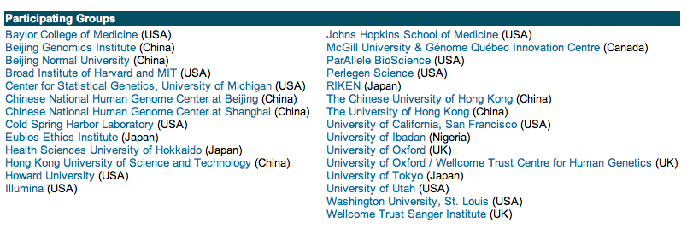
HapMap Project: Genotype validated SNPs in the dbSNP
To produce a genome-wide map of common variation
Genotype 6 Million SNPs in Four populations in Two Phases:
CEPH (CEU) (Europe - n = 90, trios)
Yoruban (YRI) (Africa - n = 90, trios)
Japanese (JPT) (Asian - n = 45)
Chinese (HCB) (Asian - n =45)
Nature 437: 1299-320, 2005
www.hapmap.org
Notes:
The second objective of the hapMap project was to characterize SNP by genotyping in major representatative population from around the world. The goal for this was to develop 600,000 SNPs genome-wide where they would have genotype each individual from four populations - Say something about trios - hapolotypes - you’ll be hearing more about that in the following talk from Dr. Crawford.

Slide 31
HapMap Samples
90 Yoruba individuals (30 parent-parent-offspring trios) from Ibadan, Nigeria (YRI)
90 individuals (30 trios) of European descent from Utah (CEU)
45 Han Chinese individuals from Beijing (CHB)
45 Japanese individuals from Tokyo (JPT)

Slide 32

Haplotype Map of the Human Genome
Goals:
Define patterns of genetic variation across human genome
Guide selection of SNPs efficiently to “tag” common variants
Public release of all data (assays, genotypes)
Phase I: 1.3 M markers in 269 people
Phase II: +2.8 M markers in 270 people

Slide 33
HapMap Project
The HapMap Project tests linkage between SNPs in various sub-populations.
For a group of linked SNPs recombination may be rare over tens of thousands of bases
A few "tag SNPs" can be used to identify genotypes for groups of linked SNPs
Makes it possible to survey the whole genome with fewer markers (1/3-1/10th)

Slide 34
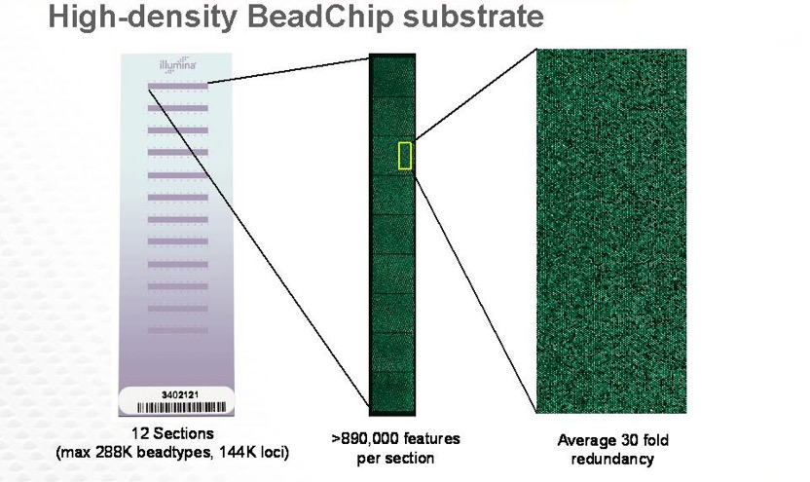
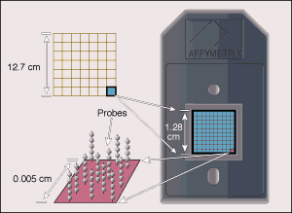
Genotyping Systems
Affymetrix
Illumina
100,000 or 500,000 Quasi-Random SNPs
100,000, 317,000, 550,000, 650,000Y SNPs
A significant proportion of common SNPs can be captured

Slide 35
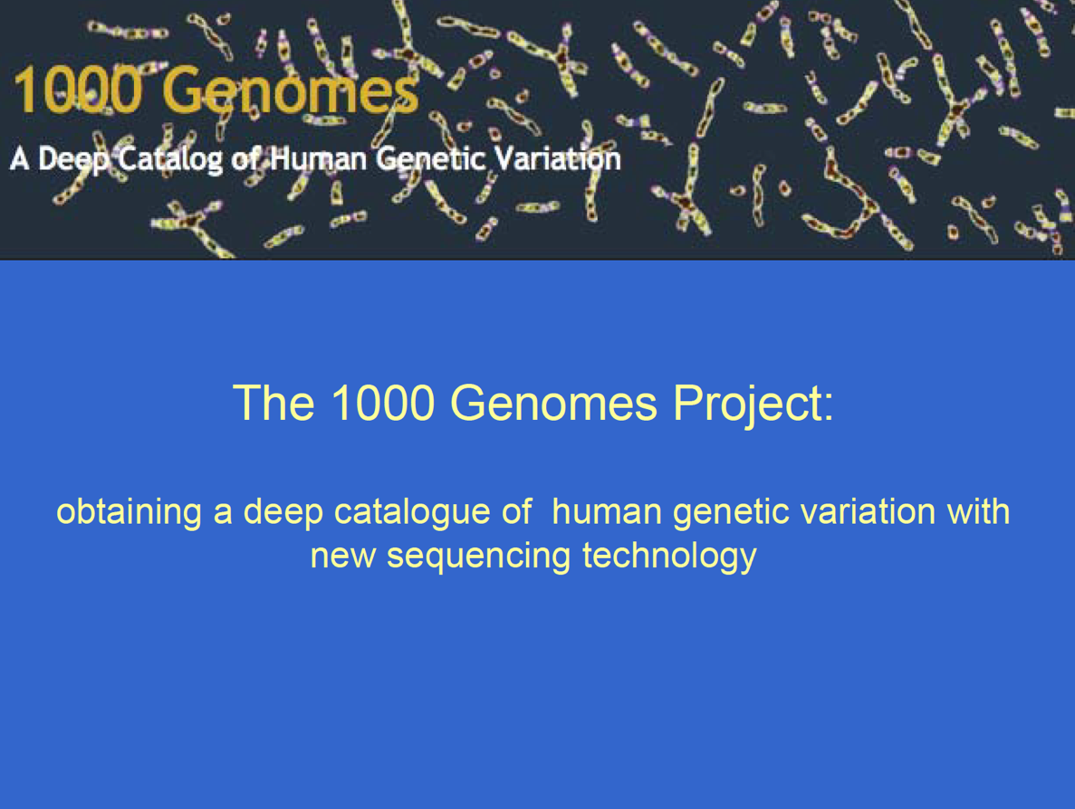
The 1,000 Genomes Project

Slide 36
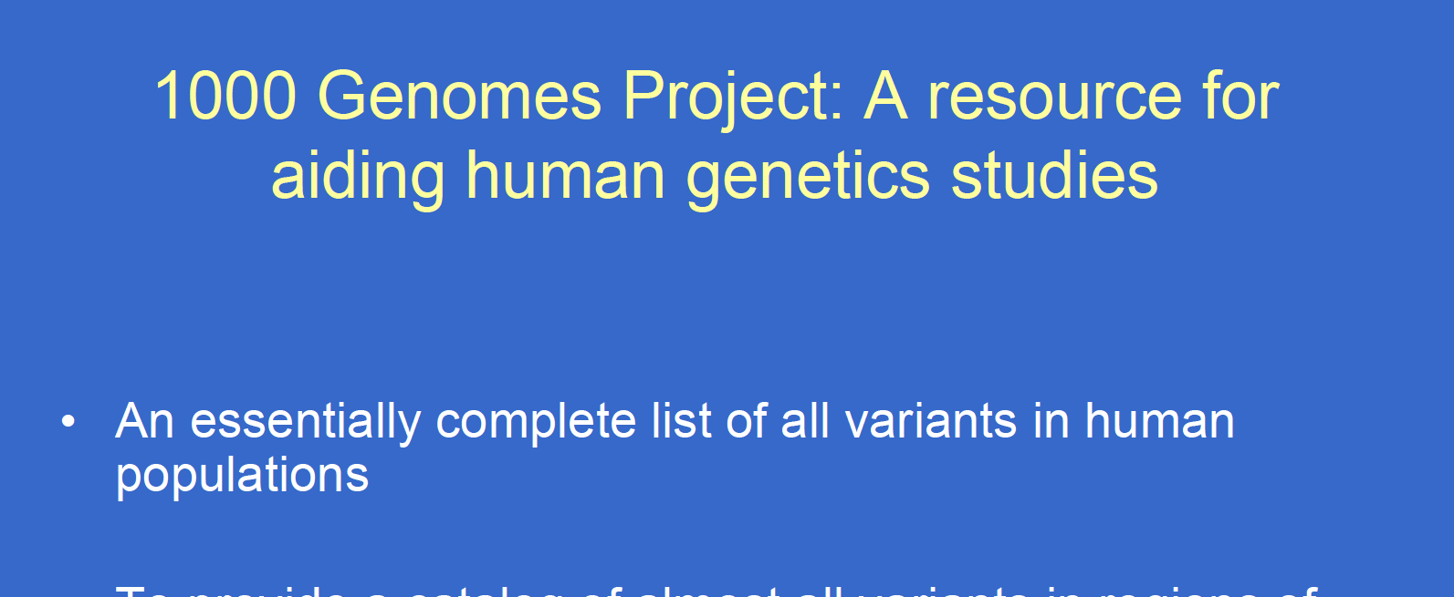

Slide 37
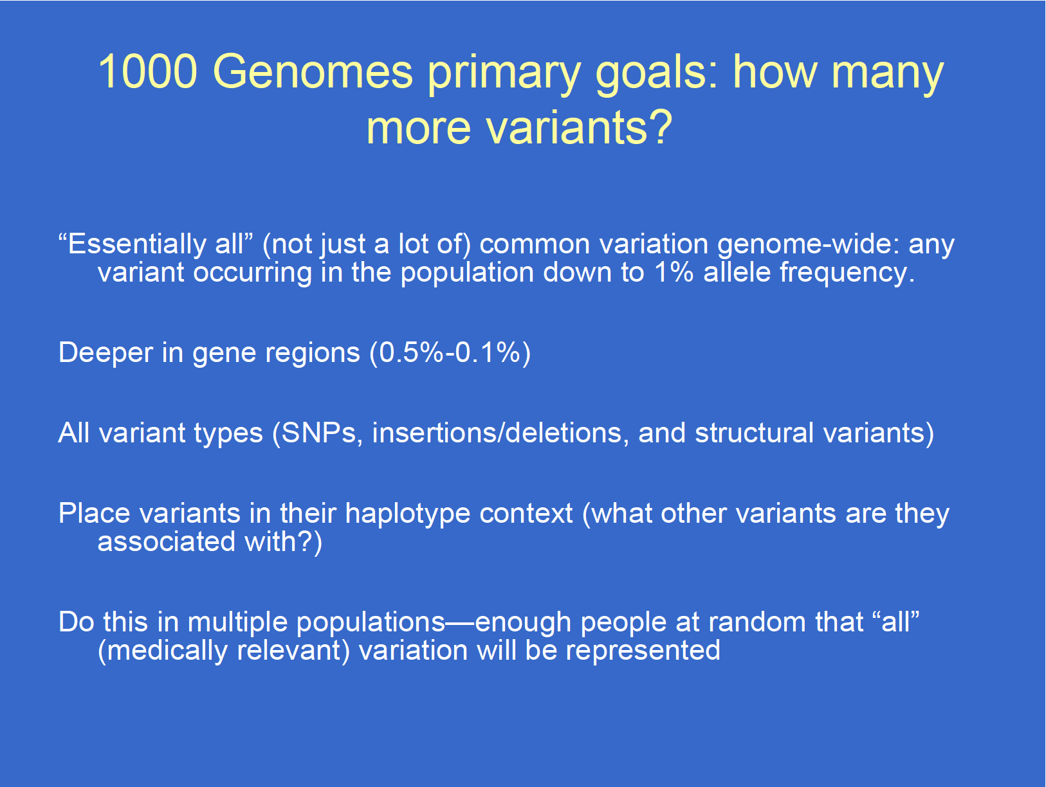

Slide 38
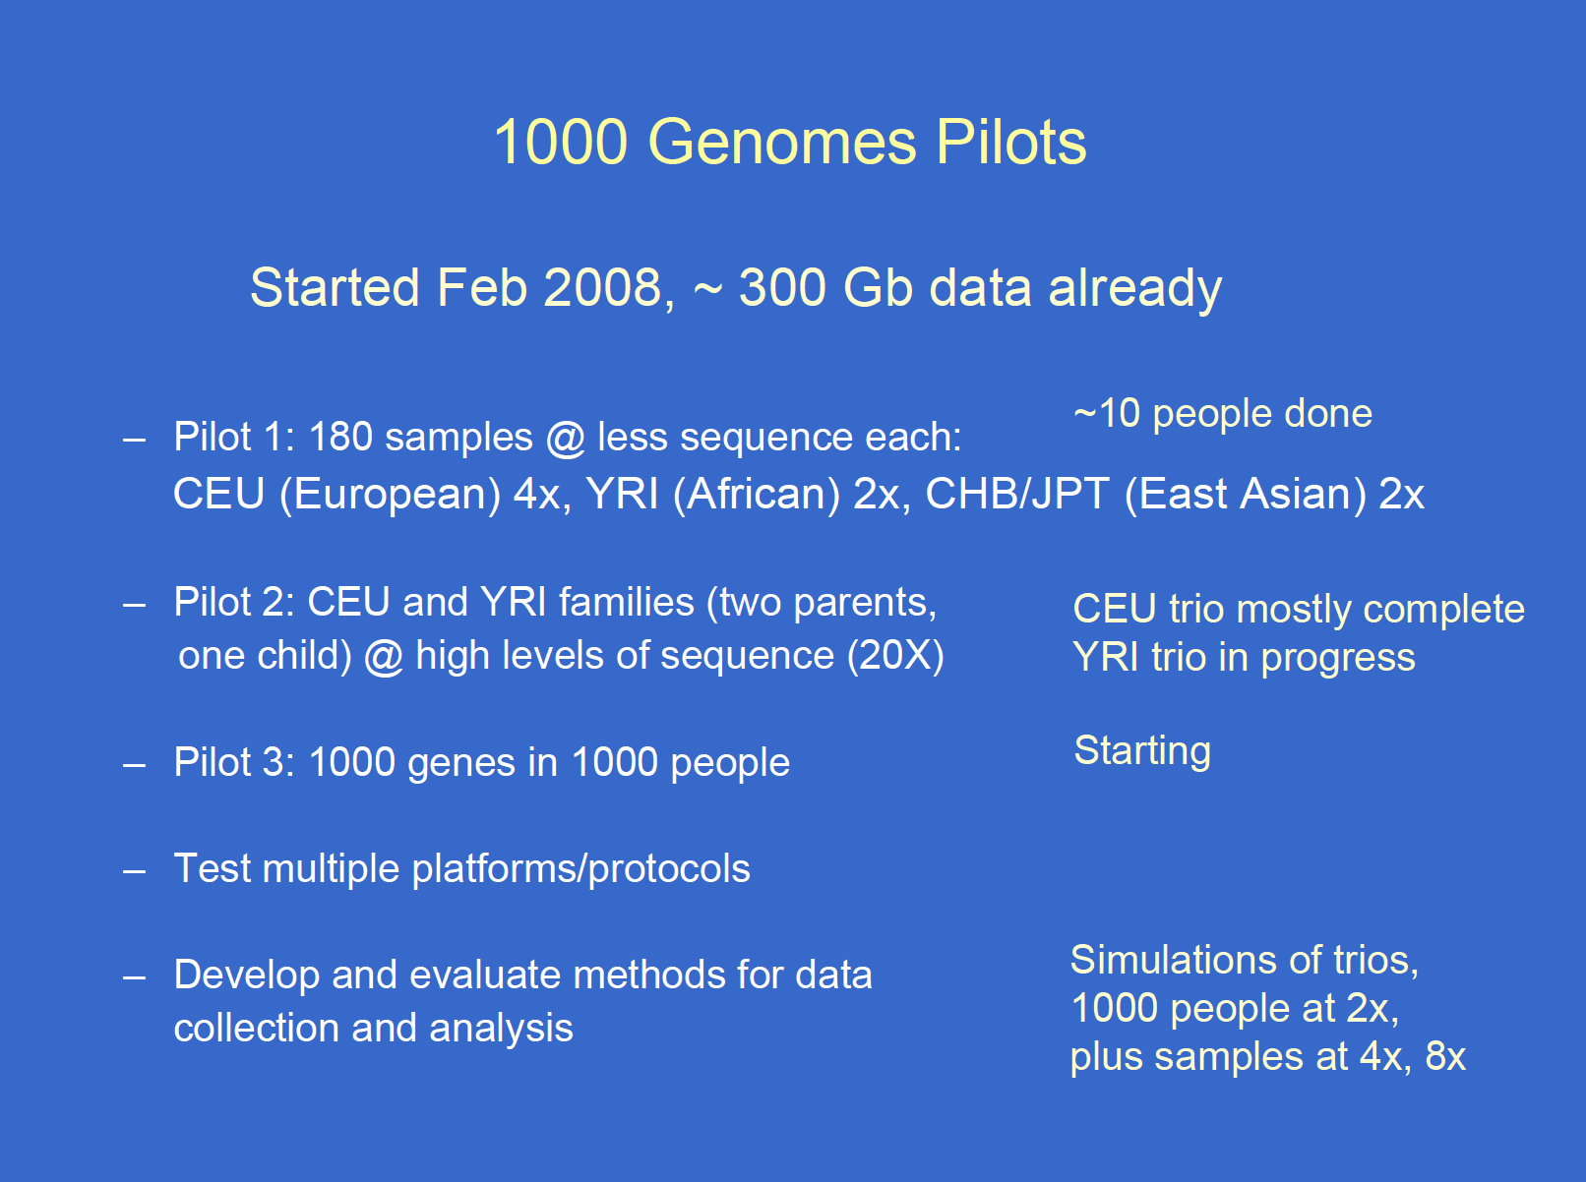

Slide 39
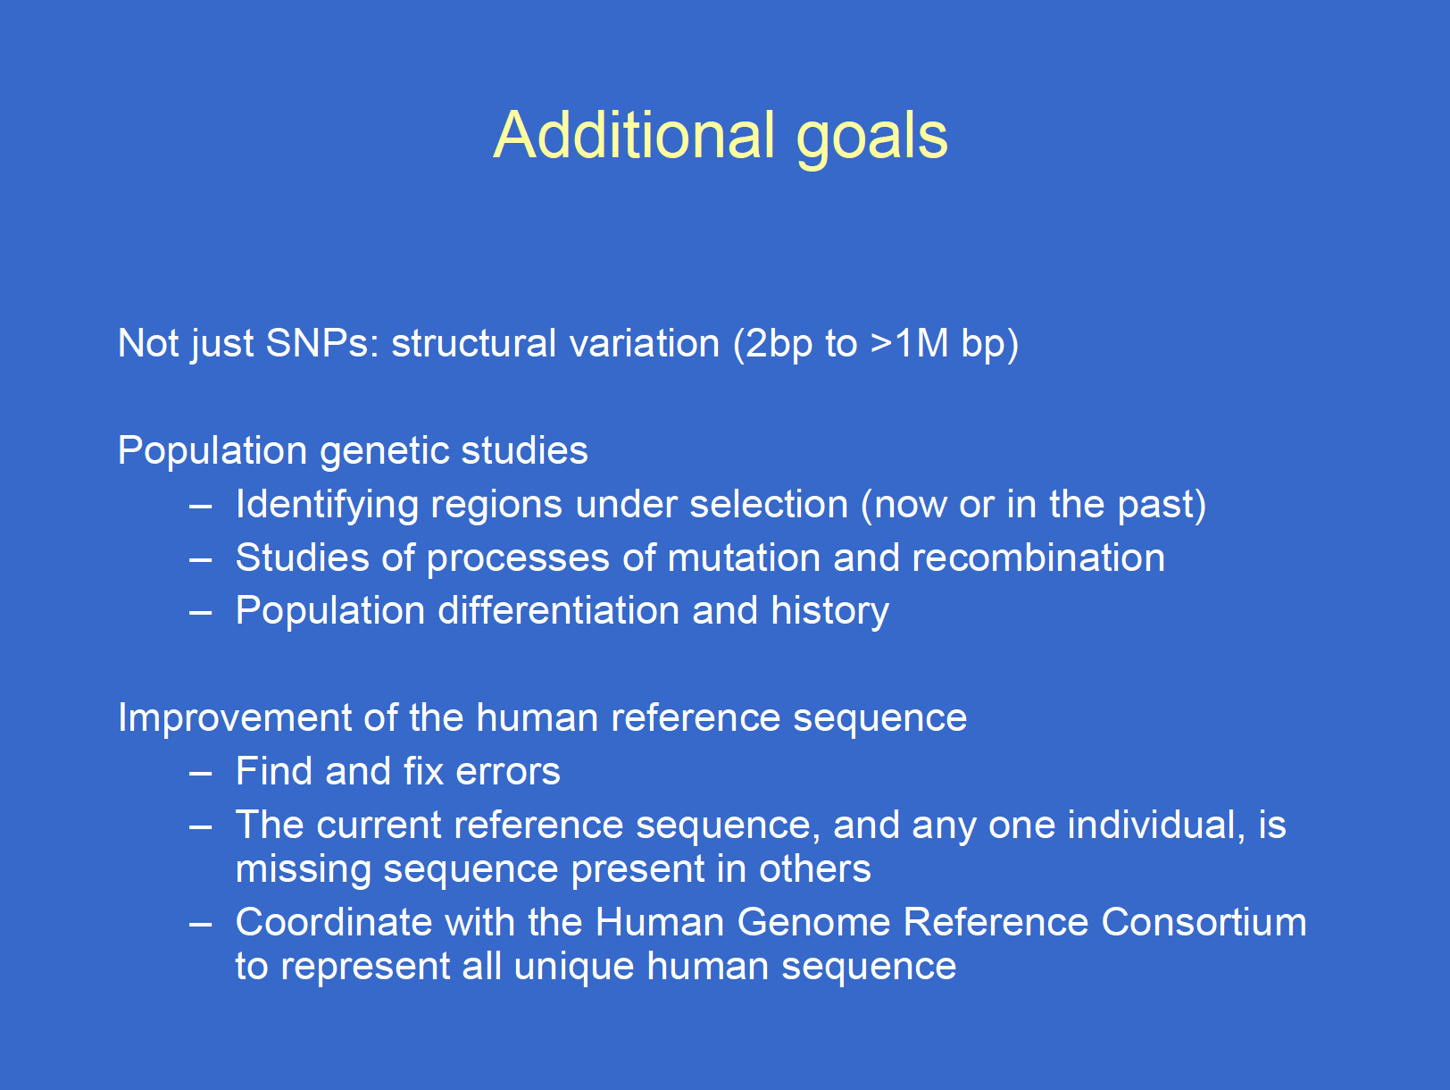

Slide 40
Hapmap, The Pilot Project and The Main Project
1000 Genomes Pilot project
Started in 2008
Paper release contained ~14 million snps
179 individuals
4 populations
Low coverage next generation sequencing
1000 Genomes Phase 1
Started in 2009
Phase 1 release has 36.6millon snps, 3.8millon indels and 14K deletions
1094 individuals
14 populations
Low coverage and exome next generation sequencing
1000 Genomes Phase 2
Started in 2011
1722 individuals
19 Populations
Low coverage and exome next generation sequencing
Notes:
This slide is just to give an idea of how things have changes since the 1000 genomes projects predecessor HapMap. So HapMap started in 2002 in the wake of the Human Genome Project. It used high throughput genotyping chips to rapidly assess variation in large numbers of invidiuals and by its finish in 2007 it has released containing more around 3 million variants across 1400 individuals from 11 different populations. As second generation sequencing technologies started to bear out their promises it because clear it would be plausible to sequence large number of individuals and the 1000 genomes project was born. We have moved from pilot phase where nearlu 200 individuals were sequenced to now where we are aiming for a total of 2500 and hope to capture almost all shared variation that exists currently in the populations we study.

Slide 41
The 1,000 Genomes Project
Currently being sequenced using 35-mer illumina reads
If you get a rare variant, may not be able to map the read to the genome
- “Reference genome” vs “de novo” assembly
Structural/CNVs –very unlikely to catch much of these. Difficult to ID these with 35-mers…
May only be good at catching rare SNPs or structural variants that are small (maybe 10 or less bp)

Slide 42
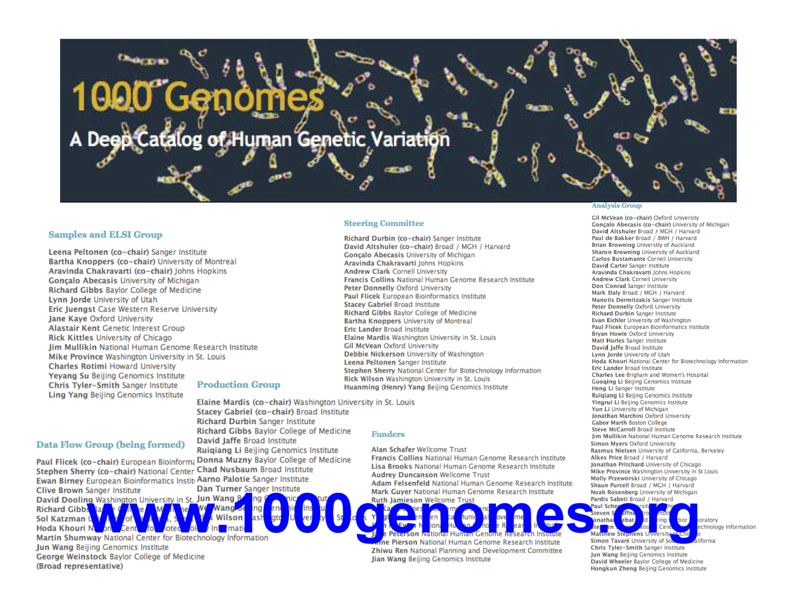

Slide 43
1000 G
61.9 M SNVs
22.4 M SNVs

Slide 44
1000 G
For more
The 1000 Genomes Project Advanced Information Laura Clarke

Slide 45
Data Availability
FTP site: ftp://ftp.1000genomes.ebi.ac.uk/vol1/ftp/
Raw Data Files
AWS Amazon Cloud: http://aws.amazon.com/1000genomes/
FTP mirror
Web site: http://www.1000genomes.org
Release Announcements
Documentation
Ensembl Style Browser: http://browser.1000genomes.org
Browse 1000 Genomes variants in Genomic Context
Variant Effect Predictor
Data Slicer
Other Tools
Notes:
Our data is available from our ftp site and on the browser, there is documentation and release announcements on the web site.

Slide 46
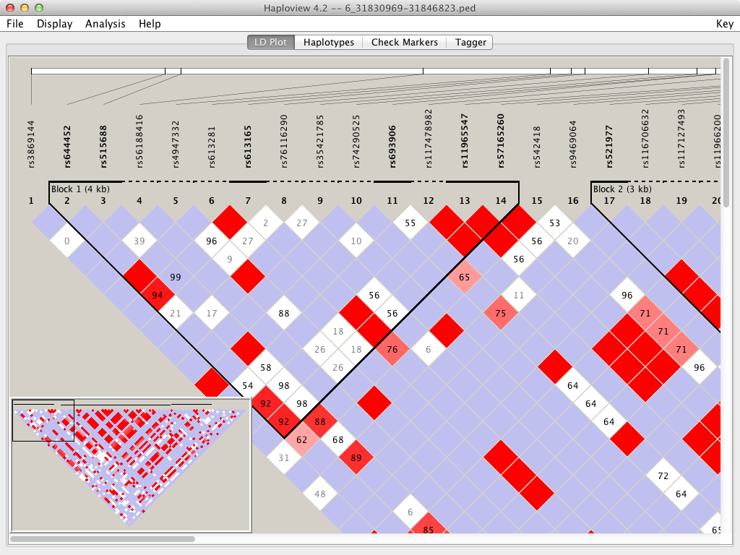
Haploview
haploview
http://www.broadinstitute.org/scientific-community/science/programs/medical-and-population-genetics/haploview
Notes:
Once the ped and info files exist you can use haploview (which is aliased on these machines to be haploview) to view the LD pattern shared for these variants in these individuals.

Slide 47
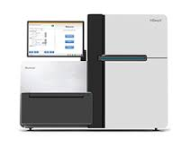

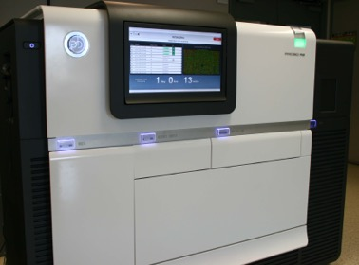
Remember: Next-generation sequencing
Complementary technologies
Can chop up DNA and read bits of fragment all at the same time – massively parallel sequencing
Illumina
Pacific Biosciences
Oxford Nanopore

Slide 48
Next-generation sequencing by BAC BIO (dark side of the moon)

Slide 49
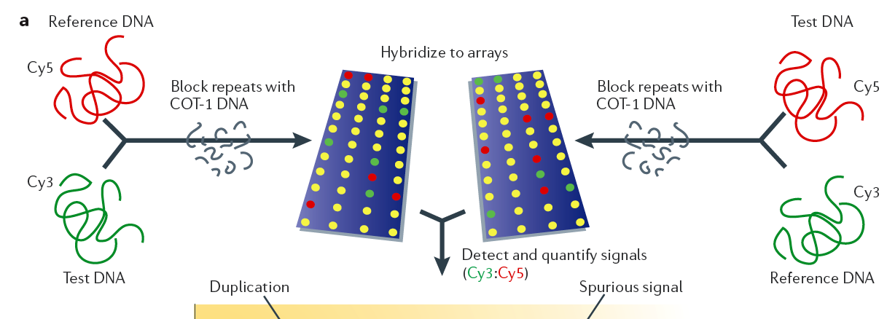
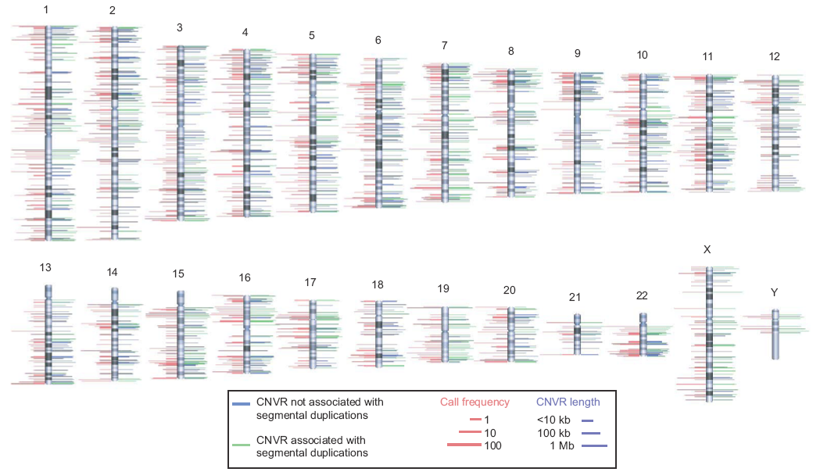
Array-CGH technology

Slide 50
Interpreting exomes and genomes: EXAC* GNOMAD
| 17 August 2016
Analysis of protein-coding genetic variation in 60,706 humans

Slide 51
EXAC
Exomes only
60,000 healthy not related
Mostly Europeans..
Mostly rare. New…

Slide 52
Sifting signal from noise in exomes
Every genome contains many rare, potentially functional variants
~500 rare missense variants
~100 LoF variants: ~20 homozygous, ~20 rare
~100 rare variants in known disease genes
5-10 recessive disease-causing mutations
1-2 de novo coding mutations
sequencing errors
In Mendelian disease patients we need to find 1-2 true causal mutations amidst this “noise”

Slide 53
Exome Aggregation Consortium (ExAC)
Latino
African
European
South Asian
East Asian
Other
1000 Genomes
ESP
ExAC

Slide 54
Lessons from ExAC
Many “healthy” people carry apparently disease-causing variants
over 20,000 reported disease variants are seen in our “healthy” samples
average ~2/person after filtering
What’s causing this?
carriers of recessive variants
some undiagnosed disease cases
lots of false positive variants (20-25%)

Slide 55
Illustration…
EXAC
GNOMAD (excellent resource)
The pro and con of aggregated data
What for
cancer baseline/ disease/ penetrance / evolution / …

